Slide 1
Ethics in AI
Yogesh Kulkarni

Slide 2
Agenda: - What is AI? - Ethics in AI

Slide 3
What is Artificial Intelligence (AI)?
ie What is Machine Learning? Deep Learning?

Slide 4
Chess: Next move?
Needs extreme expertise
Needs “intelligence”
How do you get that?
Built by lots of training.
By studying lots of past games.
This is how Humans build intelligence

Slide 5
Intelligence
Can machine (software/program) also do the same?
Can it play chess?
Can it build intelligence?
By looking at past experiences (data),
Training Data: games played, moves used, etc.
Yes, it can!! That's Artiﬁcial Intelligence.

Slide 6
Intelligence
Ability to think various domains
Ability produce something new
Ability to detect the unseen
Ability to enhance knowledge (rules, patterns)
All these, AI has started doing. The AI era has arrived!

Slide 7
Artificial Intelligence
Artiﬁcial intelligence seems to have become ubiquitous.
Replying to our emails on Gmail
Learning how to drive our cars,
Sorting our holiday photos.
etc.
Too good to be true, isn’t it, sort of Magical !!

Slide 8
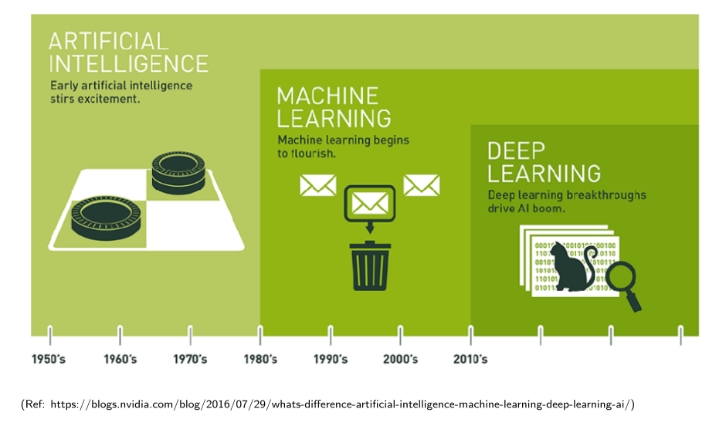
Relationship between AI, ML, DL

Slide 9
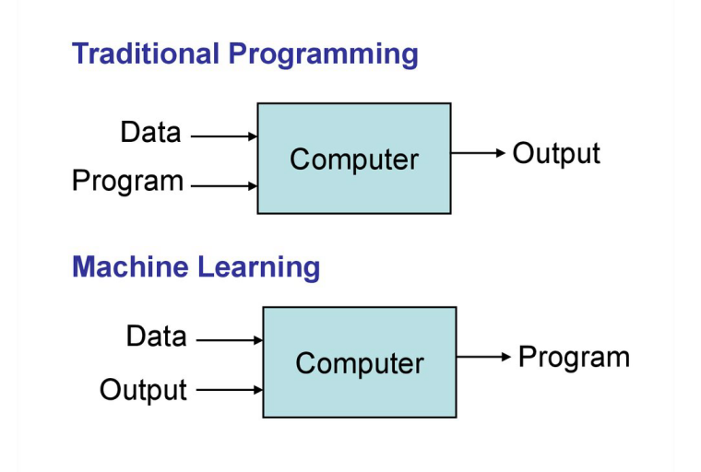
Traditional vs. Machine Learning?

Slide 10
Why Machine Learning?
Problems with High Dimensionality
Hard/Expensive to program manually
Techniques to model ‘ANY’ function given ‘ENOUGH’ data.
Job $$$

Slide 11
Why now?
Flood of data (Internet, IoT)
Increasing computational power
Easy/free availability of algorithms
Increasing support from industries

Slide 12
Ethics in AI
What are unethical practices and their results?

Slide 13
What is Ethical AI?
Ethics: Value principles that govern a person's behavior or the conducting of an activity
“What could AI do to bring about a better society?” – Margaret Mitchell (Google)
Ethical concerns range from the esoteric, such as who is the author of an AI-created work of art; to the very real and very disturbing matter of surveillance in the hands of military authorities who can use the tools with impunity to capture and kill their fellow citizens.

Slide 14
Why Ethics in AI?
AI is making many decisions.
That’s going to increase only
AI is Unbiased, an assumption
AI model needs to be:
Fairness
Explainable
Robustness
Transparency
Data Privacy

Slide 15
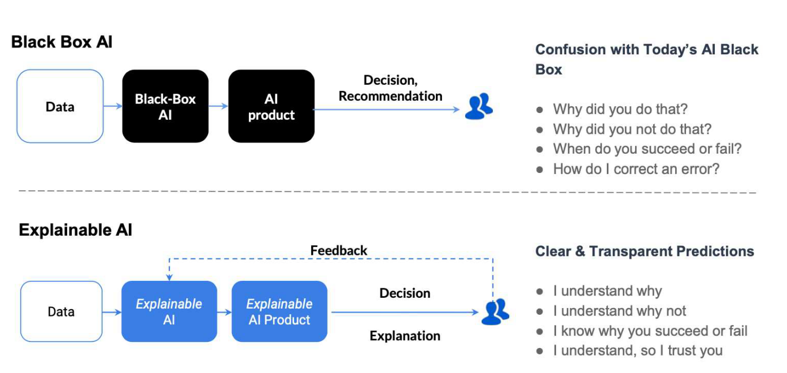
What is Explainable AI?
An explanation of how an automated system decided.
Interpretability of the predictions/results.
“Interpretability is the degree to which a human can understand the cause of a decision.” - Tim Miller
Gade, Geyik, Kenthapadi, Mithal, Taly. Explainable AI in Industry, WWW’2020

Slide 16
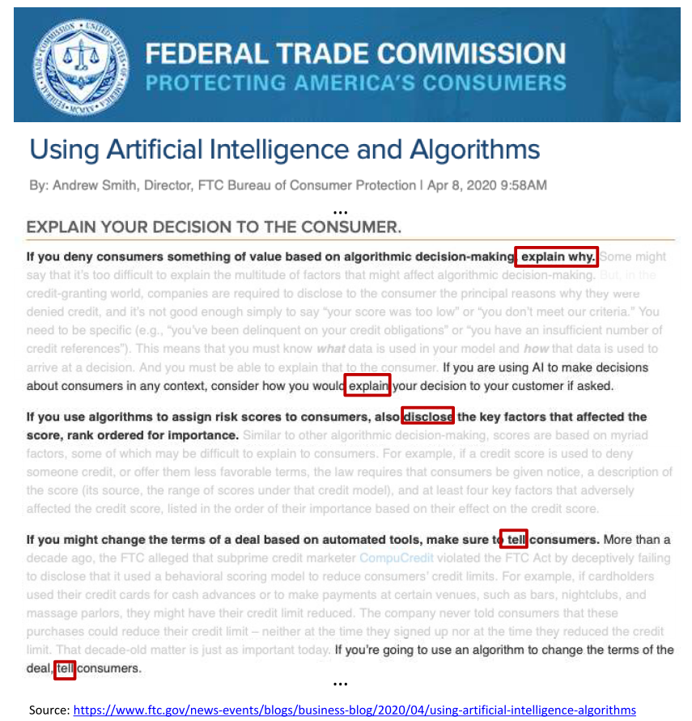
Regulatory Need
General Data Protection Regulation (GDPR): Article 22 empowers individuals with the right to demand
Massachusetts Bill H.2701: Establishes a commission on automated decision-making, transparency, fairness, and individual rights.
Illinois House Bill 3415: States predictive data analytics determining creditworthiness or hiring decisions may not include information that correlates with the applicant race or zip code.

Slide 17
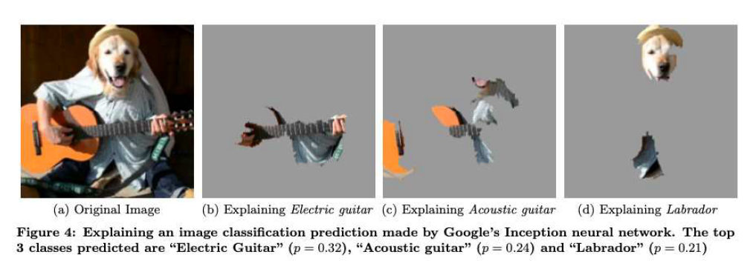
Example: Images
“Why Should I Trust You?” Explaining the Predictions of Any Classifier. KDD’2016

Slide 18
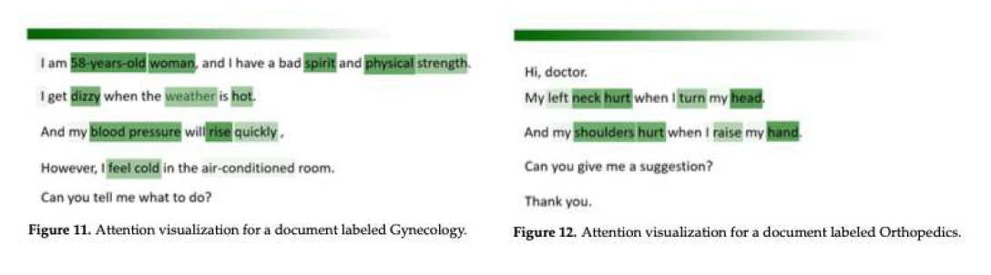
Example: Text
Outpatient Text Classification Using Attention-Based Bidirectional LSTM for Robot-Assisted Servicing in Hospital Information 2020

Slide 19
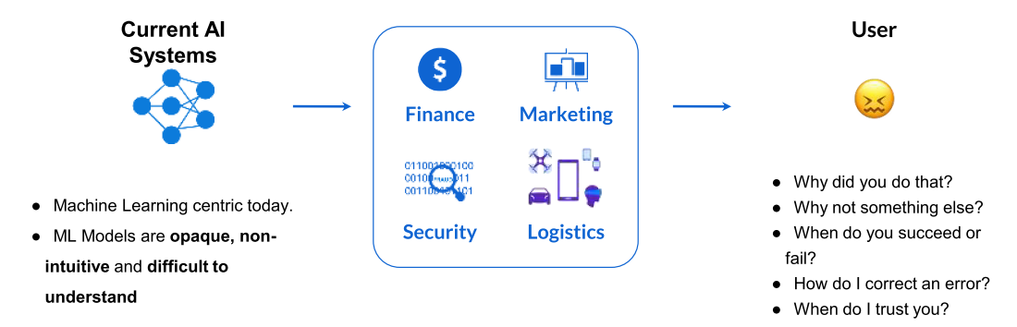
Need for Explainable AI
Explainable AI is essential for customers to understand and trust the decisions by AI.
(Explainable AI in Industry, KDD 2019 Tutorial,Sahin Cem Geyik, Krishnaram Kenthapadi & Varun Mithal )
Notes:
What is customer ask?
Who is the user?

Slide 20
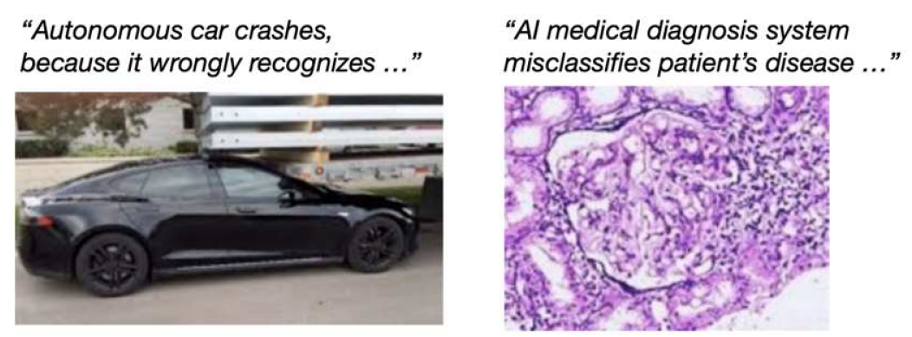
Wrong decisions: Costly and dangerous
(Credit: Samek, Binder, Tutorial on Interpretable ML, MICCAI’18)
Notes:
What is customer ask?
Who is the user?

Slide 21
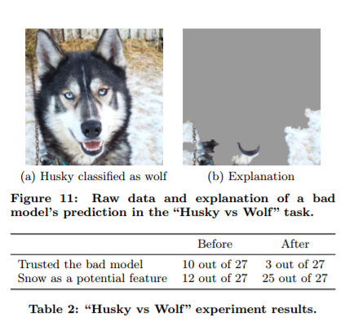
AI missed!!
Dog vs Wolf classifier
Instead of animal body features it started detecting based on ‘presence of snow’.
So Siberian Husky (a dog) got classified as Wolf.
Training data of wolves was with snow landscapes.
http://innovation.uci.edu/2017/08/husky-or-wolf-using-a-black-box-learning-model-to-avoid-adoption-errors/

Slide 22
-- “AI can make decisions better, but
Can it make better decisions”--
Notes:
What is customer ask?
Who is the user?

Slide 23
AI as Black Box
Why did the AI system do that?
Why didn’t the AI system do something else?
When did the AI system succeed?
When did the AI system fail?
When does the AI system give enough confidence in the decision that you can trust it?
How can the AI system correct an error?
Explainable AI (XAI) – A Perspective, Saurabh Kaushik

Slide 24
Three Key Pillars of Explainable AI
Reasonable AI: The ability to understand the reasoning behind each individual prediction
Traceable AI: The ability to trace prediction process from algorithm to data.
Understandable AI: The ability to fully understand the AI decision-making is based
“Right to Explanation” – GDPR
Explainable AI (XAI) – A Perspective, Saurabh Kaushik

Slide 25
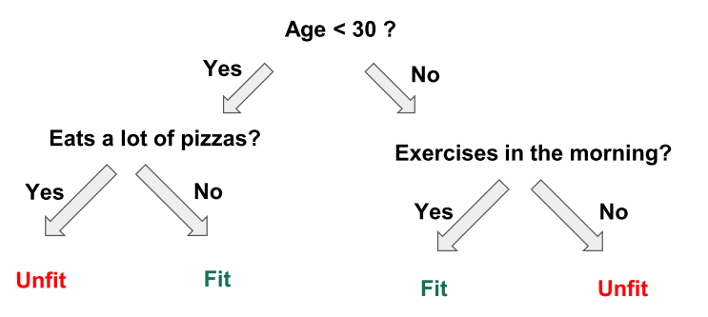
Achieving Explainable AI
Prediction explanations
Important features
Features weights
Decision tree plotting
Build an interpretable model using libraries like LIME, SHAP, etc.
Explainable AI in Industry, KDD 2019 Tutorial,Sahin Cem Geyik, Krishnaram Kenthapadi & Varun Mithal

Slide 26
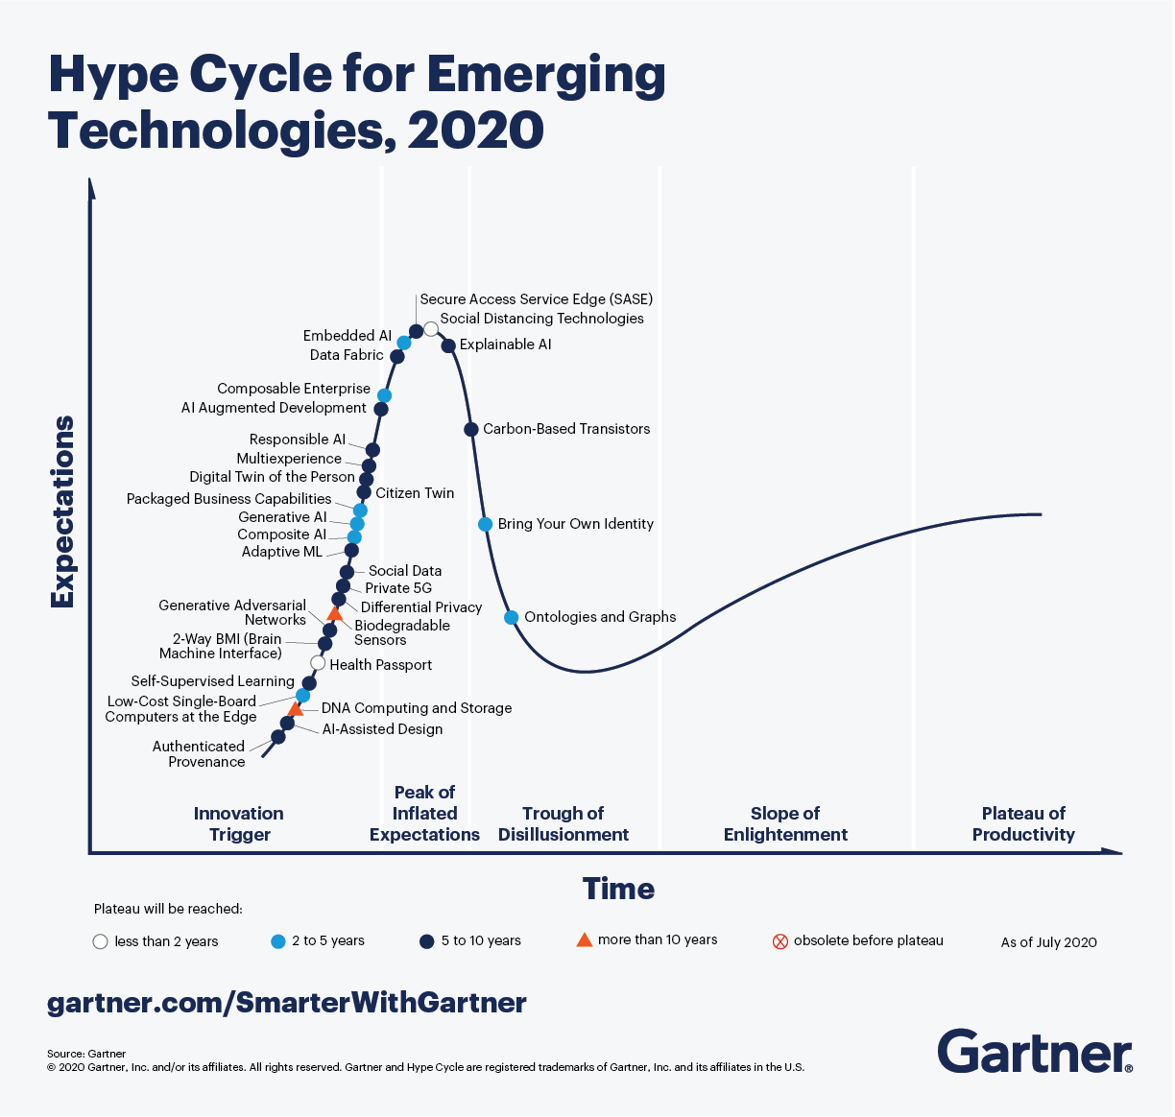
Upwinds

Slide 27
Responsible and Ethical AI
AI adoption is increasing
Need to check quality of outcomes
May have bias leading to issues, risks, etc.
Need to operate AI practices that can be fair, trustworthy and transparent and it takes safety, privacy and societal aspects at large.

Slide 28
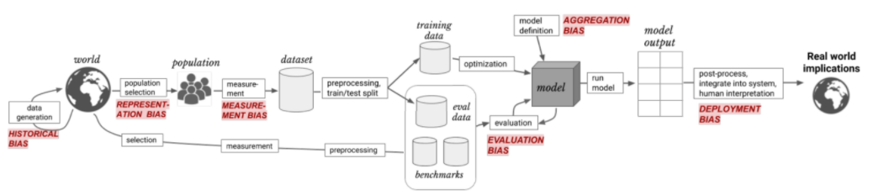
Types of Bias
(Ref: Responsible AI : https://kkm24132.github.io/ResponsibleAI/)

Slide 29
Considerations
Understanding the AI system’s functioning for safe and reliable deployment
Understand why a specific decision was made?
Consistency across stakeholders
Incorrect decisions leading to exclusion from access to services or benefits
Accountability of AI decisions
Privacy Risks
Security Risks
(Ref: Niti Ayog report on “Responsible AI”)

Slide 30
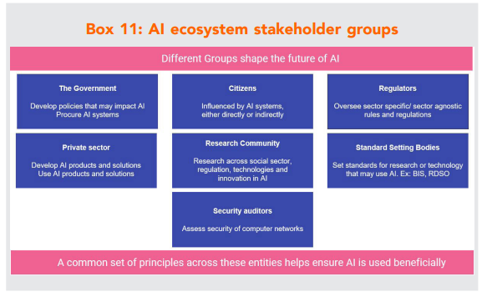
Stakeholders
(Ref: Niti Ayog report on “Responsible AI”)

Slide 31
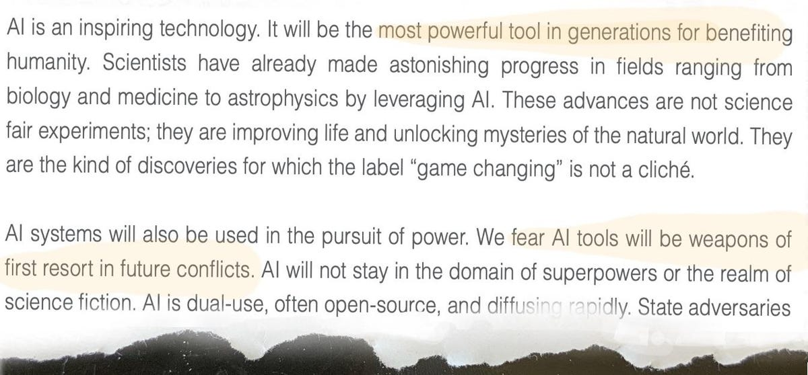
AI Arms Race
(Ref: The National Security Commission on AI's Final Report in March warned the U.S. is not ready for global conflict that employs AI.)

Slide 32

Generative AI
None of these people are real.
Deep Fake wave: fake images and fake recordings and fake text and fake videos can mislead people about the circumstances of events.
Societal biases get baked in the language models.
(Ref: StyleGAN Karras et al. 2019)

Slide 33
Role of AI, a re-look
Be assistive, not replacement of humans
Data belongs to creator
Results should be explainable to be compliant
Not technological but socio-technological problem
Be inclusive

Slide 34
Solution: ML interpretability
Answer on Model bias, fairness, ethics
Do we check causality of features?
Do we have ability to debug and know more specifics?
Are there any regulatory requirements?
Do we trust model’s outcomes and to what extent?

Slide 35
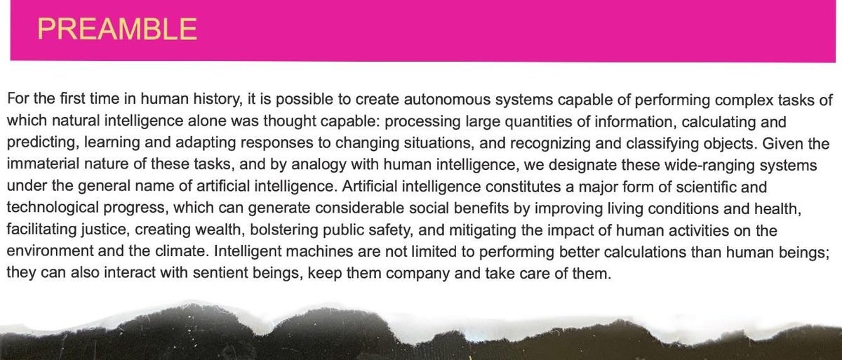
Code of Ethics
(Ref: The University of Montreal's Montreal Declaration is one of the most well-known statements of principle on AI.)

Slide 36
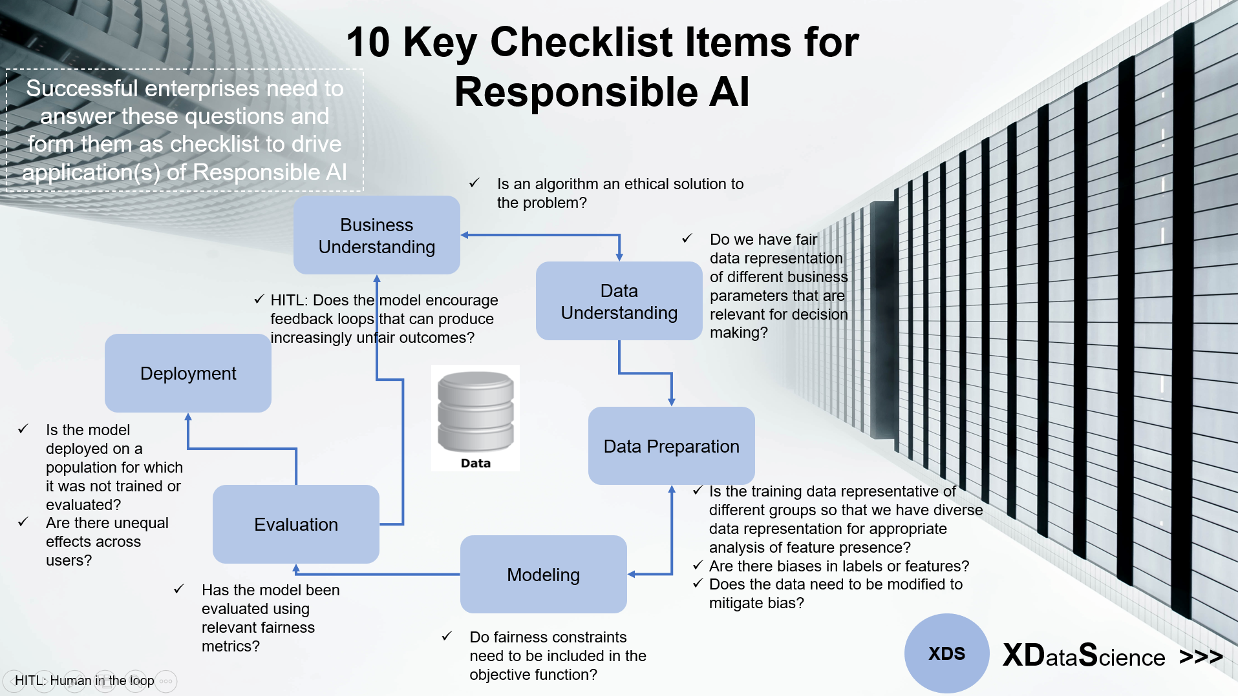
The Checklist
(Ref: Responsible AI : https://kkm24132.github.io/ResponsibleAI/)

Slide 37
Btw, thoughts to ponder on…
‘AI is biased’ because of its training/data
‘Explainable AI’ is to understand how/why it is biased
AI is tries to mimic Human intelligence, right?
We expect AI to be unbiased/ethical…
But then…
Human are biased too…
Should AI mimic that?

Slide 38
Thank You
yogeshkulkarni@yahoo.com

